Slide 1
PV,PVC and Storage Class
OW

Slide 2
What is PV and PVC?
The PersistentVolume subsystem provides an API for users and administrators that abstracts details of how storage is provided from how it is consumed.
To do this, we introduce two new API resources: PersistentVolume and PersistentVolumeClaim.
A PersistentVolume (PV) is a piece of storage in the cluster that has been provisioned by an administrator or dynamically provisioned using Storage Classes. It is a resource in the cluster just like a node is a cluster resource.
A PersistentVolumeClaim (PVC) is a request for storage by a user. It is similar to a Pod. Pods consume node resources and PVCs consume PV resources. Pods can request specific levels of resources (CPU and Memory). Claims can request specific size and access modes (e.g., they can be mounted ReadWriteOnce, ReadOnlyMany or ReadWriteMany

Slide 3
Provisioning and Reclaim
Two ways PVs can provisioned:
Static
Dynamic
Reclaim types
Retain
Delete

Slide 4
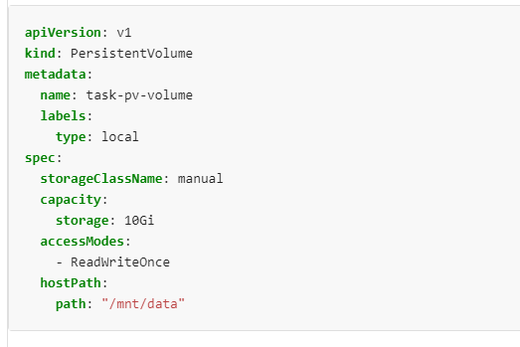
Pv yaml example

Slide 5
Yaml explain
Capacity: Generally, a PV will have a specific storage capacity. This is set using the PV's capacity attribute.
VolumeMode:Kubernetes supports two volumeModes of PersistentVolumes: Filesystem and Block.
volumeMode is an optional API parameter. Filesystem is the default mode used when volumeMode parameter is omitted.

Slide 6
Access Mode
ReadWriteOnce
the volume can be mounted as read-write by a single node. ReadWriteOnce access mode still can allow multiple pods to access the volume when the pods are running on the same node.
ReadOnlyMany
the volume can be mounted as read-only by many nodes.
ReadWriteMany
the volume can be mounted as read-write by many nodes.
ReadWriteOncePod
the volume can be mounted as read-write by a single Pod.

Slide 7
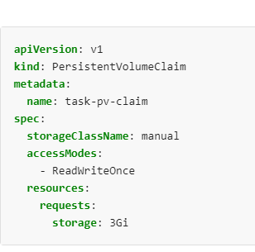
PVC

Slide 8
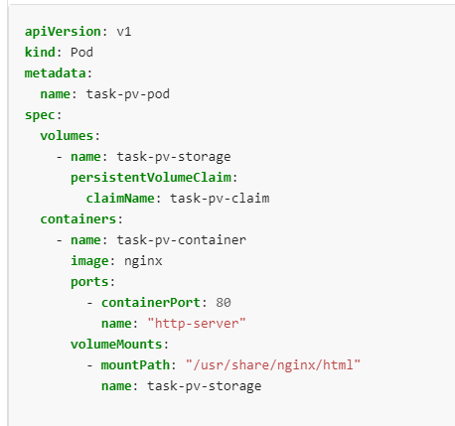
Map to pod

Slide 9
StorageClass
A StorageClass provides a way for administrators to describe the "classes" of storage they offer. Different classes might map to quality-of-service levels, or to backup policies, or to arbitrary policies determined by the cluster administrators.
Each StorageClass contains the fields provisioner, parameters, and reclaimPolicy, which are used when a PersistentVolume belonging to the class needs to be dynamically provisioned.

Slide 10
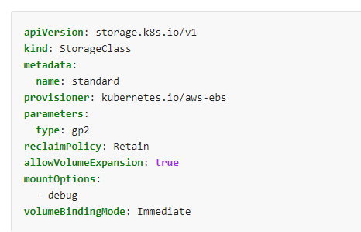
yaml

